Slide 1
Kubernetes as Infrastructure
DTA What The Hack
September 2018

Slide 2
Challenge Scenario
Customer has existing web app, they want to modernize it and run it in containers in the cloud
Fab Medical conference website
Customer is asking you to help them with this process
Get them into Kubernetes in Azure and help them operationalize it.

Slide 3
Fab Medical App
Simple Node.js application
Two components:
content-Web
Web site with 4 pages (home, sessions, speakers, and stats)
Each page hits a backend API to retrieve its content from a JSON datasource
content-API
3 functions that return pre-canned JSON data
In more complex demo, data is stored/retrieved from MongoDB/CosmosDB. We simplified for time today, but you can do this in a longer form hack with your customers

Slide 4
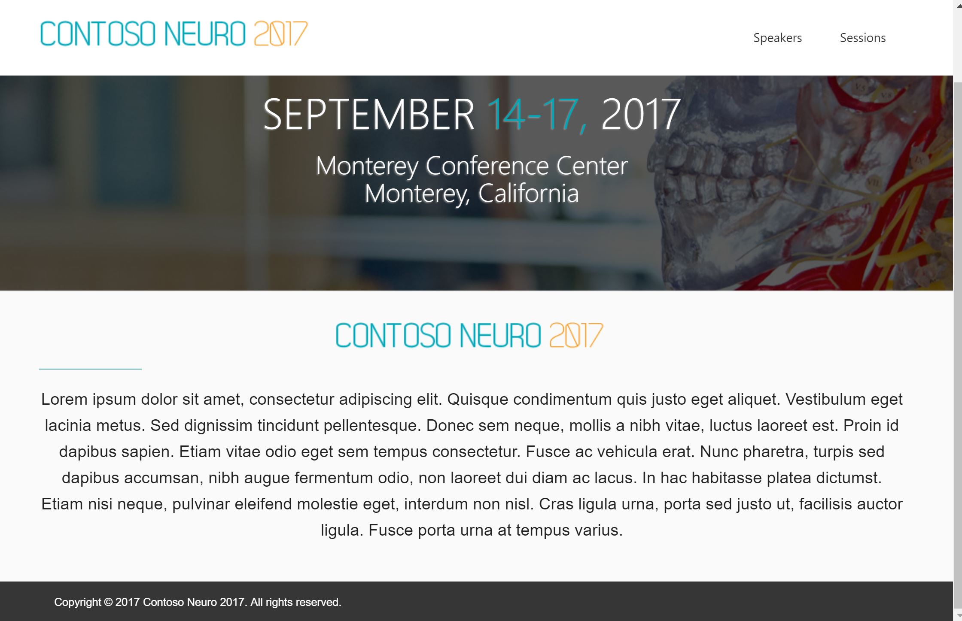
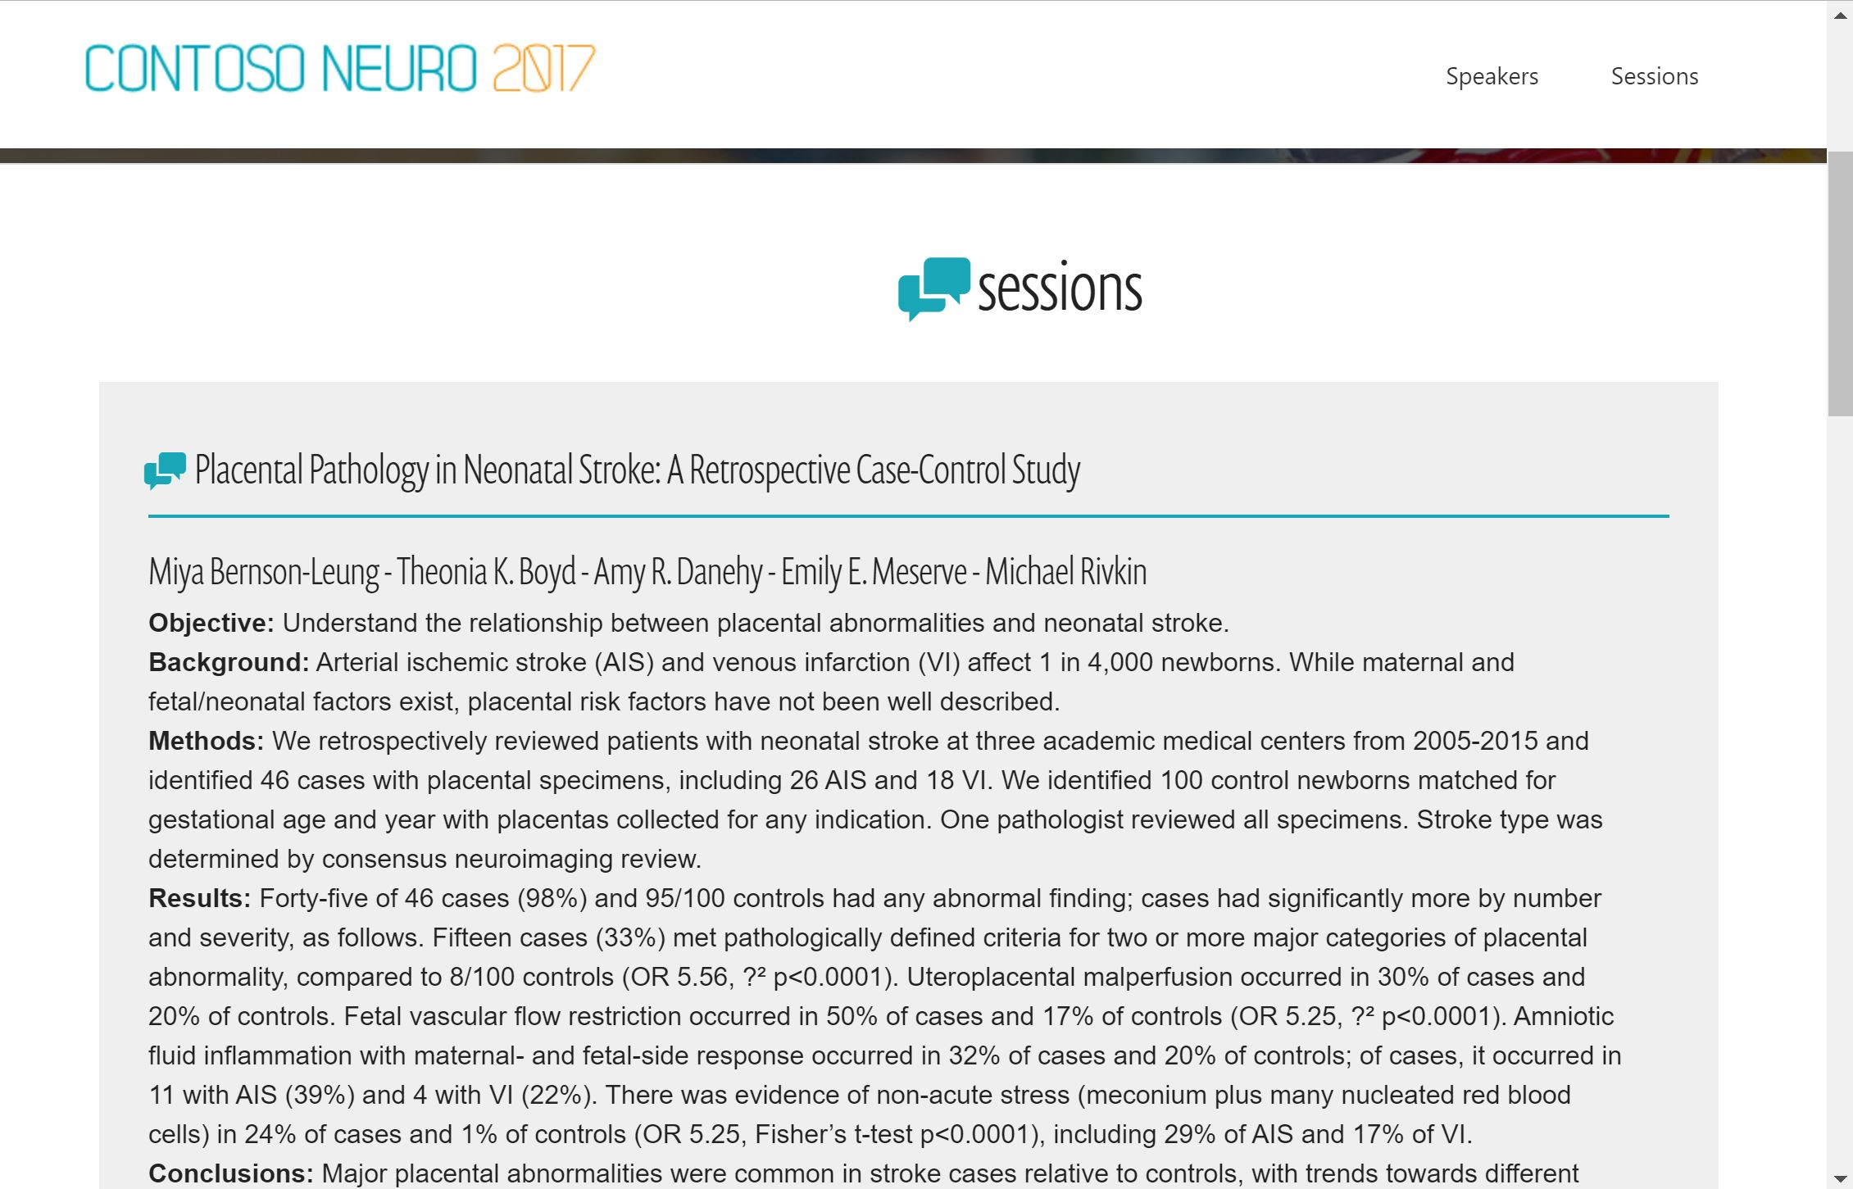

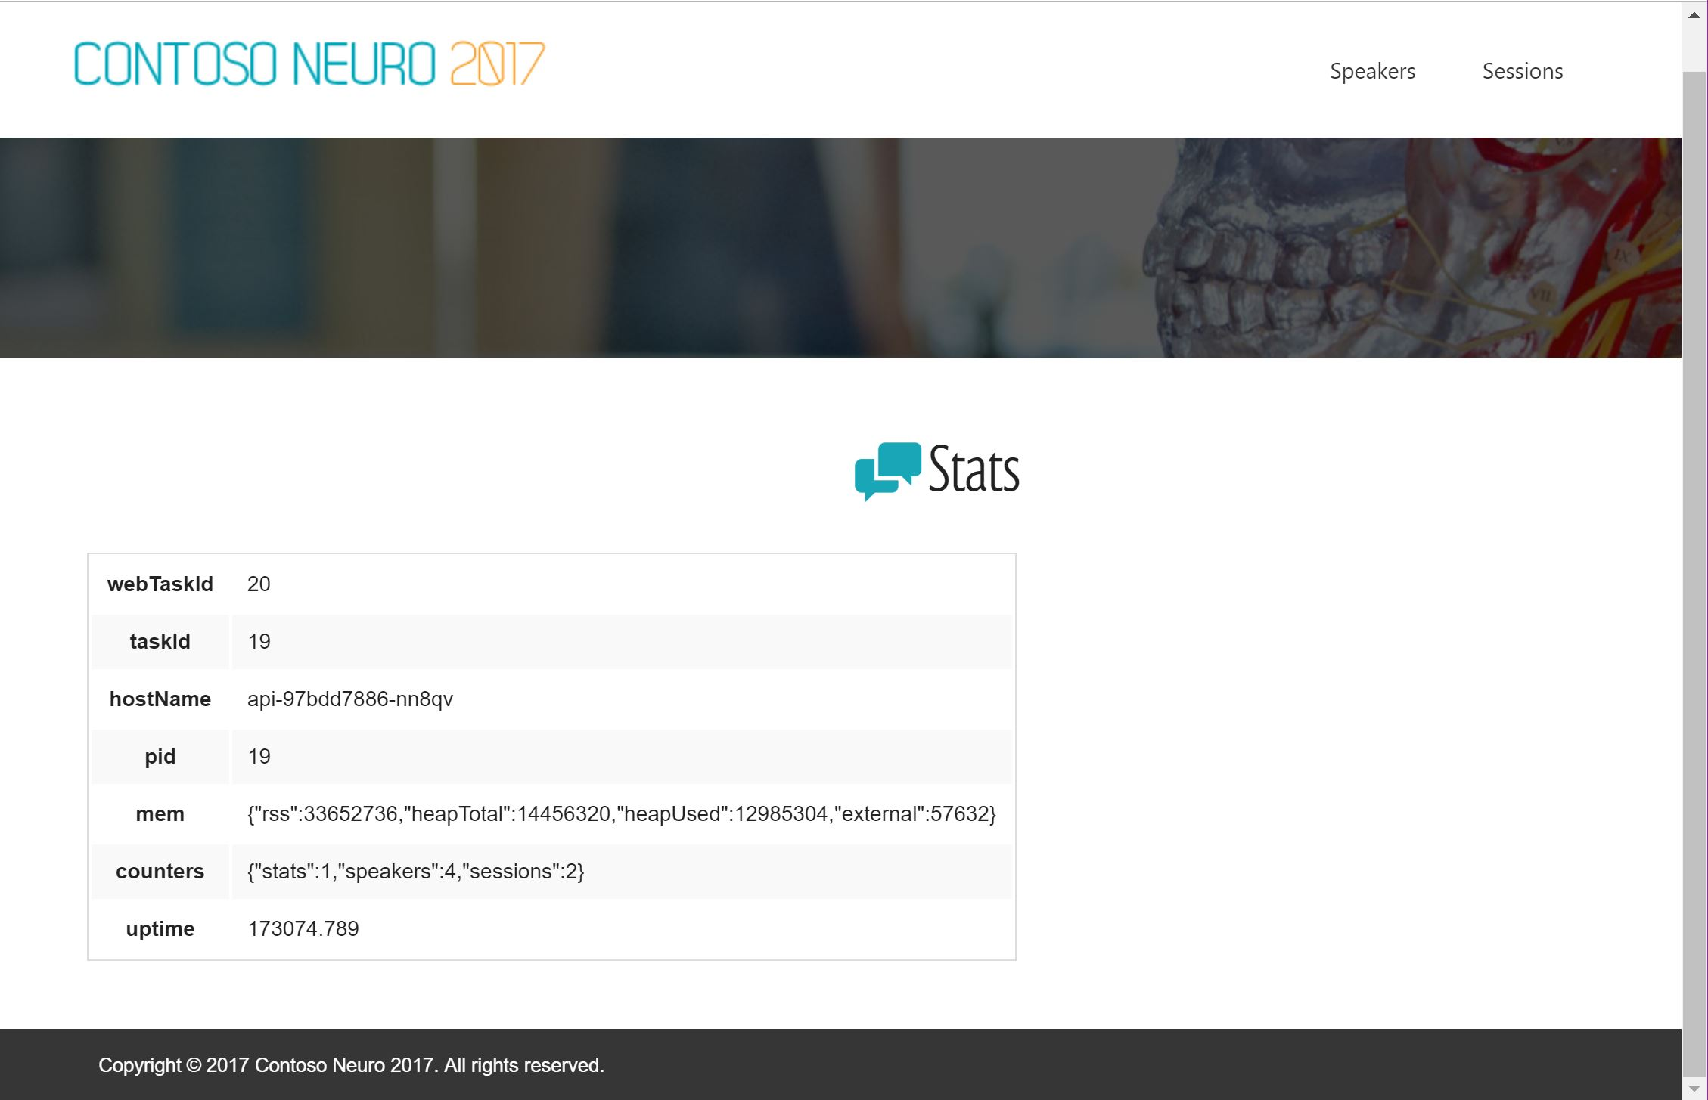
Fab Medical Website
Index.html
Sessions.html
Speakers.html
Stats.html

Slide 5
Introducing Kubernetes What’s all the hype?!

Slide 6
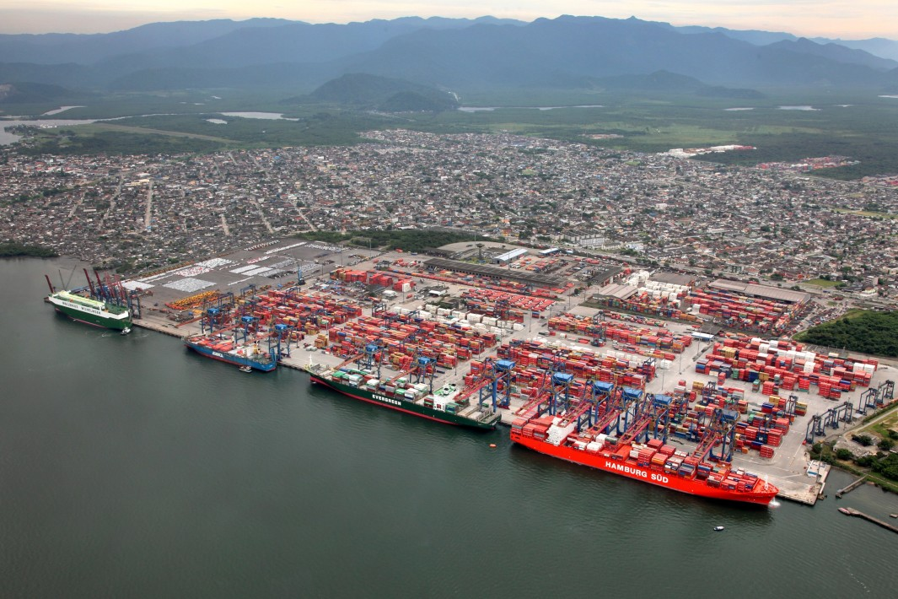
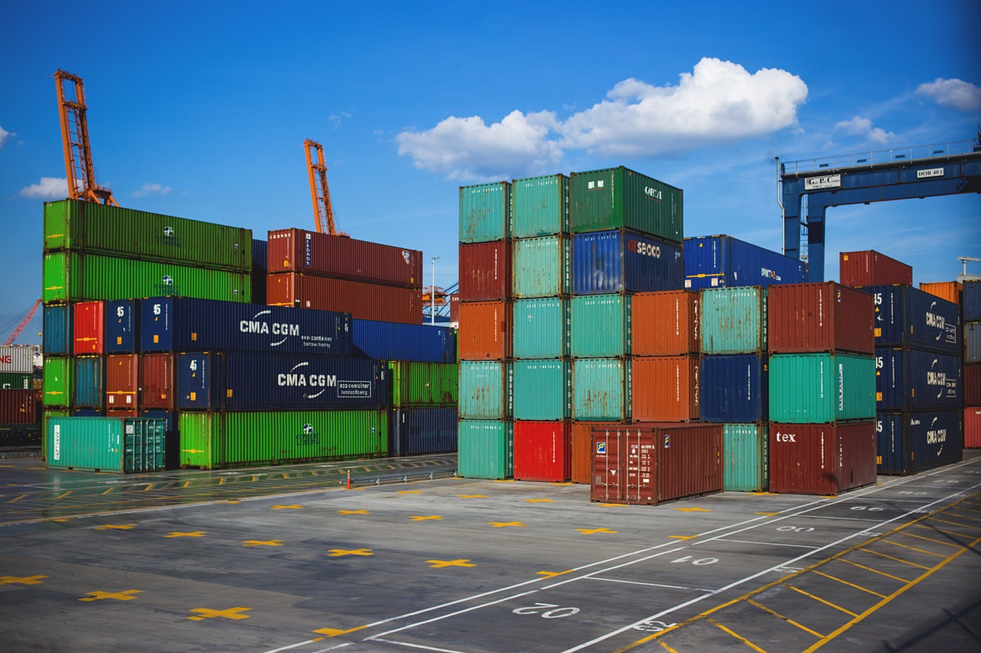
Review: What is a Container?
Containers are an application-centric way to deliver high-performing, scalable applications on the infrastructure of your choice.

Slide 7
What is a Container?
VM
VM
VM
VM
App A
App B
App C
Guest OS
Guest OS
Guest OS
Guest OS
Hypervisor
Hypervisor
Host OS
Host OS
Server
Server
Notes:
VM
Hypervisor => VMWare, HyperV
Can do turtles, all the way down till your machine feels like it’s running from a potato

Slide 8
What is a Container?
VM
VM
VM
VM
App A
App B
App C
Guest OS
Guest OS
Guest OS
Container Engine
Guest OS
Hypervisor
Hypervisor
Host OS
Host OS
Server
Server
Notes:
VM
Hypervisor => VMWare, HyperV
Can do turtles, all the way down till your machine feels like it’s running from a potato

Slide 9
What is a Container?
VM
VM
VM
VM
App A
App B
App C
Container
App A
Guest OS
Guest OS
Guest OS
Bins/Libs
Container Engine
Guest OS
Hypervisor
Hypervisor
Host OS
Host OS
Server
Server
Notes:
VM
Hypervisor => VMWare, HyperV
Can do turtles, all the way down till your machine feels like it’s running from a potato

Slide 10
What is a Container?
VM
VM
VM
VM
App A
App A
App B
Container
Container
Container
App A
App B
App C
Guest OS
Guest OS
Guest OS
Bins/Libs
Bins/Libs
Bins/Libs
Container Engine
Guest OS
Hypervisor
Hypervisor
Host OS
Host OS
Server
Server
Notes:
VM
Hypervisor => VMWare, HyperV
Can do turtles, all the way down till your machine feels like it’s running from a potato

Slide 11
Ok, I’ve got containers.
Now what?

Slide 12
I’m going to want more VMs with containers!
VM
VM
Container
Container
Container
Container
Container
Container
App A
App B
App C
App A
App B
App C
Bins/Libs
Bins/Libs
Bins/Libs
Bins/Libs
Bins/Libs
Bins/Libs
Container Engine
Container Engine
Guest OS
Guest OS
Hypervisor
Hypervisor
Host OS
Host OS
Server
Server
Notes:
VM
Hypervisor => VMWare, HyperV
Can do turtles, all the way down till your machine feels like it’s running from a potato

Slide 13
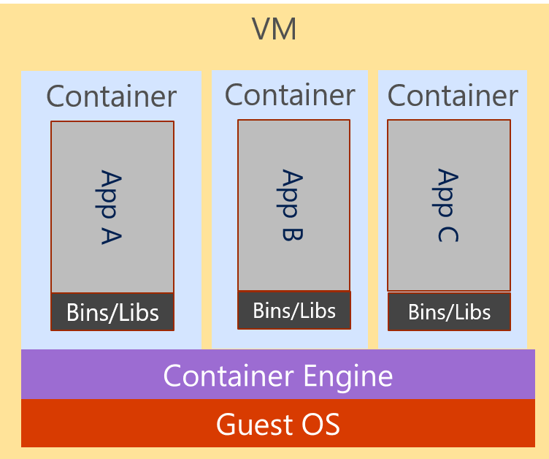
And more… and more!
Notes:
VM
Hypervisor => VMWare, HyperV
Can do turtles, all the way down till your machine feels like it’s running from a potato

Slide 14
And more… and more… CHAOS!!!
Notes:
VM
Hypervisor => VMWare, HyperV
Can do turtles, all the way down till your machine feels like it’s running from a potato

Slide 15
What is a Container Orchestrator?

Slide 16
What is a Container Orchestrator?
Container Orchestrator
Notes:
VM
Hypervisor => VMWare, HyperV
Can do turtles, all the way down till your machine feels like it’s running from a potato

Slide 17
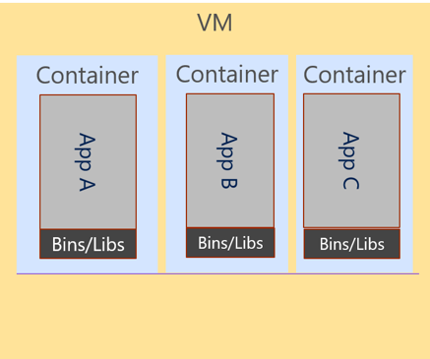
What is a Container Orchestrator?
Cluster
Container Orchestrator
Notes:
VM
Hypervisor => VMWare, HyperV
Can do turtles, all the way down till your machine feels like it’s running from a potato

Slide 18
What is a Container Orchestrator?
Cluster
VM
Container Orchestrator
Guest OS
Hypervisor
Host OS
Server
Notes:
VM
Hypervisor => VMWare, HyperV
Can do turtles, all the way down till your machine feels like it’s running from a potato

Slide 19
What is a Container Orchestrator?
Container orchestrators group hosts together to form a cluster, and fulfill these requirements:
Are fault tolerant
Can scale on demand
Use resource optimally
Discover other applications automatically
Accessible from the external world
Updates and roll-backs without downtime

Slide 20
The elements of orchestration
Scheduling
Affinity/anti-affinity
Health monitoring
Failover
Scaling
Networking
Service discovery
Coordinated app upgrades

Slide 21
What is a Container Orchestrator?
Cluster
VM
Container Orchestrator
Guest OS
Hypervisor
Host OS
Server
Notes:
VM
Hypervisor => VMWare, HyperV
Can do turtles, all the way down till your machine feels like it’s running from a potato

Slide 22
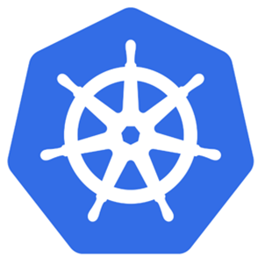
Kubernetes is a Container Orchestrator!
Cluster
VM
Kubernetes
Guest OS
Hypervisor
Host OS
Server
Notes:
VM
Hypervisor => VMWare, HyperV
Can do turtles, all the way down till your machine feels like it’s running from a potato

Slide 23
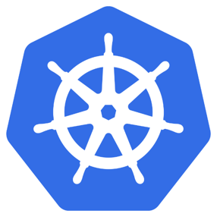
What is Kubernetes?
"Kubernetes is an open-source system for automating deployment, scaling, and management of containerized applications."
Kubernetes comes from the Greek word κυβερνήτης:, which means helmsman or ship pilot, ie: the captainer of a container ship.

Slide 24
Kubernetes has a Master & Cluster of “Nodes”
Cluster
VM
Master Node
Kubernetes
Node
Node
Node
Node
Node
Node
Guest OS
Hypervisor
Host OS
Server
Notes:
VM
Hypervisor => VMWare, HyperV
Can do turtles, all the way down till your machine feels like it’s running from a potato

Slide 25
Azure Kubernetes Service (AKS)
AKS reduces the complexity and operational overhead of managing Kubernetes by offloading much of that responsibility to Azure.
You only pay for the agent nodes within your clusters, not for the master nodes

Slide 26
AKS is Kubernetes (Master) as a Service
Cluster
Kubernetes
Master
Node
Node
Node
Node
Node
Node
Notes:
VM
Hypervisor => VMWare, HyperV
Can do turtles, all the way down till your machine feels like it’s running from a potato

Slide 27
Azure Kubernetes Service (AKS)
Azure Kubernetes Service (AKS)
Get started easily
$ az aks create -g myResourceGroup -n myCluster --generate-ssh-keys
\ Running ..
$ az aks install-cli
Downloading client to /usr/local/bin/kubectl ..
$ az aks get-credentials -g myResourceGroup -n myCluster
Merged "myCluster" as current context ..
$ kubectl get nodes
NAME STATUS AGE VERSION
aks-mycluster-36851231-0 Ready 4m v1.8.1
aks-mycluster-36851231-1 Ready 4m v1.8.1
aks-mycluster-36851231-2 Ready 4m v1.8.1

Slide 28
Azure Kubernetes Service (AKS)
Azure Kubernetes Service (AKS)
Manage an AKS cluster
$ az aks list –o table
Name Location ResourceGroup KubernetesRelease ProvisioningState
------------------ ---------- -------------- ------------------- -------------------
myCluster westus2 myResourceGroup 1.7.7 Succeeded
$ az aks upgrade -g myResourceGroup -n myCluster –-kubernetes-version 1.8.1
\ Running ..
$ kubectl get nodes
NAME STATUS AGE VERSION
aks-mycluster-36851231-0 Ready 12m v1.8.1
aks-mycluster-36851231-1 Ready 8m v1.8.1
aks-mycluster-36851231-2 Ready 3m v1.8.1
$ az aks scale -g myResourceGroup -n myCluster --agent-count 10
\ Running ..

Slide 29
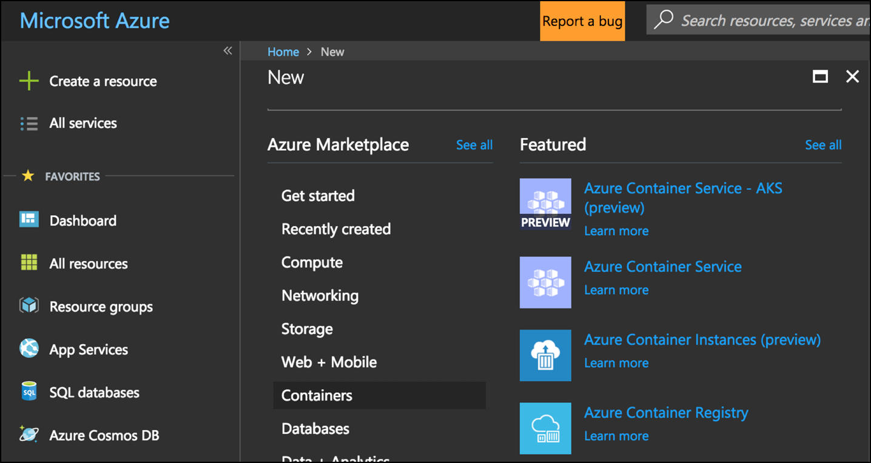
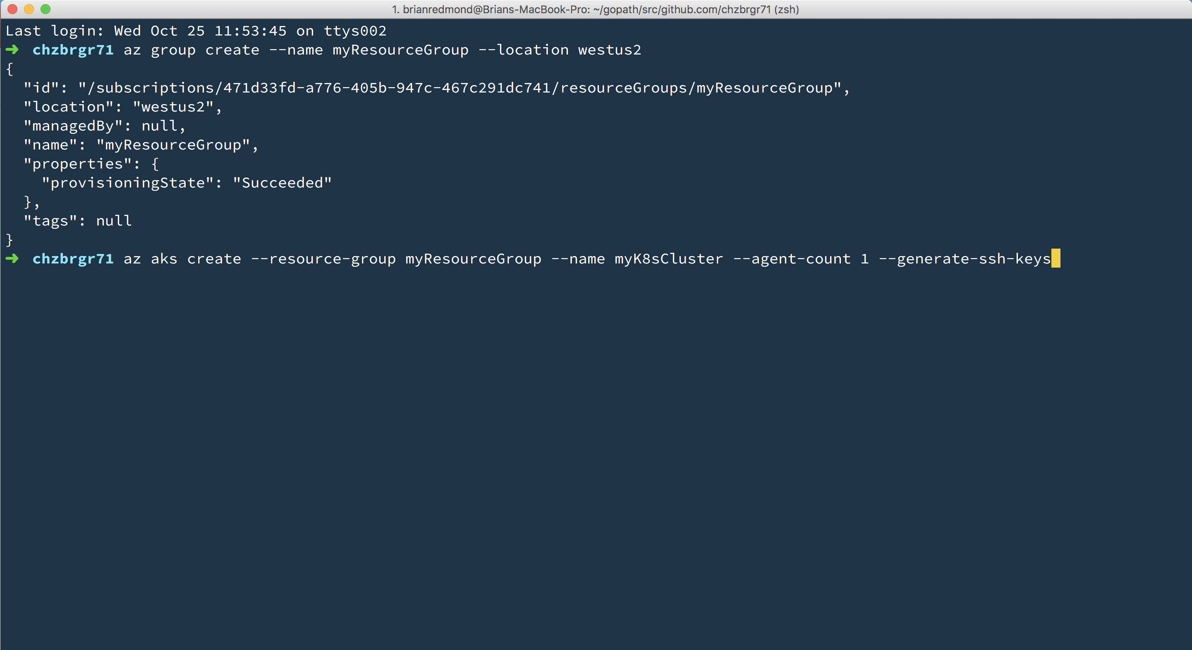
Azure Kubernetes Service (AKS)
Azure Kubernetes Service (AKS)
Create AKS via Portal, Azure CLI, or ARM template

Slide 30
Challenge 1
Your First Kubernetes Cluster
Install the recommended tool-set:
Windows Subsystem for Linux
Azure CLI
Visual Studio Code
Get “kubectl” installed
Create a new, multi-node AKS cluster
Use kubectl to prove that the cluster is a multi-node cluster and is working

Slide 31
Kubernetes Fundamentals Pods, Deployments, & Services, Oh my!

Slide 32
Kubernetes @ 10,000ft
Cluster
Kubernetes
Master
Node
Node
Node
Node
Node
Node
Notes:
VM
Hypervisor => VMWare, HyperV
Can do turtles, all the way down till your machine feels like it’s running from a potato

Slide 33
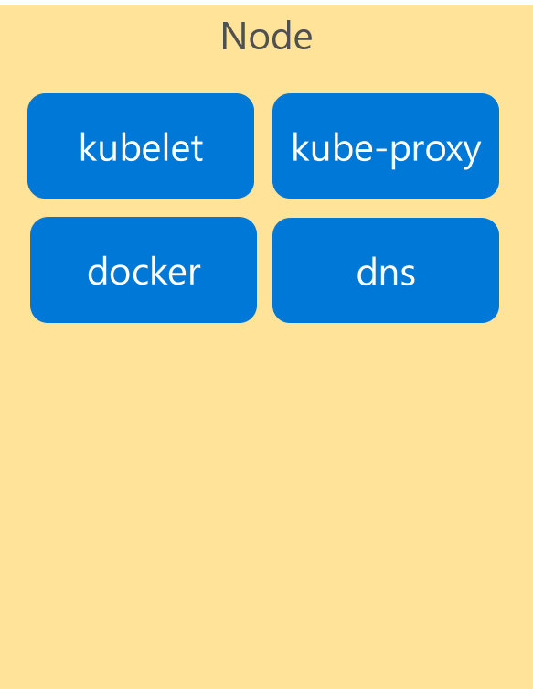
Kubernetes Architecture Components
Cluster
Master
Node
api-server
kubelet
kube-proxy
controller-manager
docker
dns
etcd
scheduler
*Azure Managed
Notes:
If we look inside the VM nodes in a Kubernetes clusters, we’ll see a whole set of services that are running on each.
These are containers themselves!
These services are how Kubernetes handles management of the nodes and things that run on them.
I’m going explain these now briefly…

Slide 34
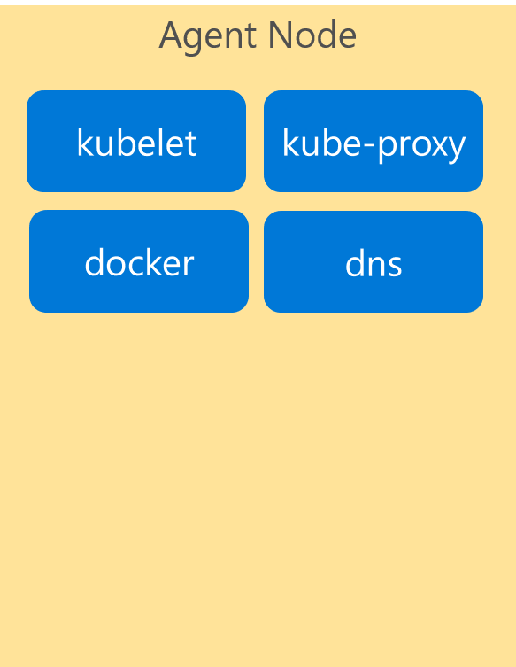
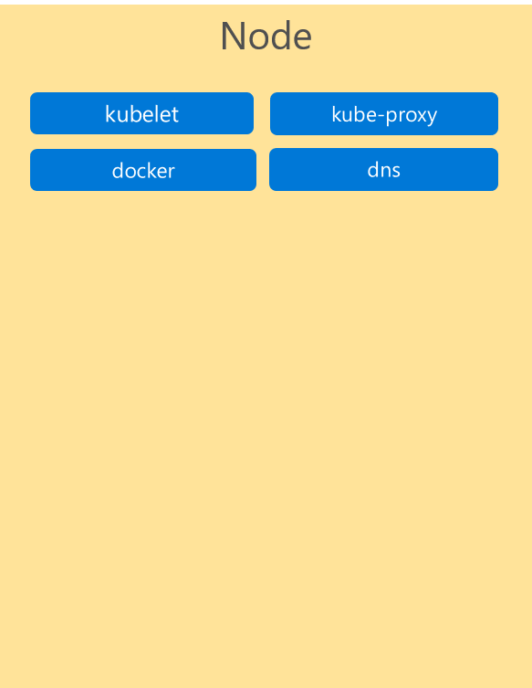
Kubernetes Architecture Components
Cluster
Master
Node
Kube stuff
Kube stuff
api-server
kubelet
kube-proxy
docker
dns
controller-manager
etcd
scheduler
*Azure Managed
Notes:
Now all of these services… forget about them for now!
They’re just the stuff that makes Kubernetes run.
You can read all about them in the docs, and probably will learn more about them as you become more familiar with the system.
But for today… we want to focus on the core components and concepts.
IF you focus on these, you’ll get lost.
Let’s keep it simple for now.

Slide 35
Kubernetes Architecture Components
Where do the Containers go?
Container
Container
Container
App A
App B
App C
Bins/Libs
Bins/Libs
Bins/Libs

Slide 36
Kubernetes Architecture Components
Introducing…. Pods!
Pod
Pod
Pod
Container
Container
Container
App A
App B
App C
Bins/Libs
Bins/Libs
Bins/Libs
Containers go inside Pods!

Slide 37
Kubernetes Architecture Components
Introducing…. Pods!
Pod
Pod
Pod
Container
App A
Container
App B
Container
App C
Containers go inside Pods!

Slide 38
Kubernetes Architecture Components
Cluster
Master Node
Node
api-server
kubelet
kube-proxy
controller-manager
docker
dns
Pod
App A
Pod
App B
Pod
App C
etcd
scheduler
*Azure Managed
Notes:
VM
Hypervisor => VMWare, HyperV
Can do turtles, all the way down till your machine feels like it’s running from a potato

Slide 39
Kubernetes Architecture Components
Pods
Cluster
Master
Node
Kube stuff
Kube stuff
api-server
kubelet
kube-proxy
docker
dns
controller-manager
Pod
App A
Pod
App B
Pod
App C
etcd
scheduler
*Azure Managed
Notes:
Now all of these services… forget about them for now!
They’re just the stuff that makes Kubernetes run.
You can read all about them in the docs, and probably will learn more about them as you become more familiar with the system.
But for today… we want to focus on the core components and concepts.
IF you focus on these, you’ll get lost.
Let’s keep it simple for now.

Slide 40
Kubernetes Architecture Components
Cluster
Master Node
Node
api-server
kubelet
kube-proxy
Pod
App A
Pod
App B
Pod
App D
controller-manager
docker
dns
Pod
App A
Pod
App B
Pod
App C
etcd
scheduler
Pod
App C
Pod
App C
*Azure Managed
Notes:
VM
Hypervisor => VMWare, HyperV
Can do turtles, all the way down till your machine feels like it’s running from a potato

Slide 41
Kubernetes Architecture Components
Pods
Cluster
Master
Node
Kube stuff
Kube stuff
api-server
kubelet
kube-proxy
docker
dns
Pod
App A
Pod
App B
Pod
App D
controller-manager
Pod
App A
Pod
App B
Pod
App C
etcd
scheduler
Pod
App C
Pod
App C
*Azure Managed
Notes:
Now all of these services… forget about them for now!
They’re just the stuff that makes Kubernetes run.
You can read all about them in the docs, and probably will learn more about them as you become more familiar with the system.
But for today… we want to focus on the core components and concepts.
IF you focus on these, you’ll get lost.
Let’s keep it simple for now.

Slide 42
Pods
pod
pod
ratings-api
ratings-web
port
3000
port
8080
pod
ratings-db
port
27017

Slide 43
Deployment
label
app=ratings-web , tier=web
image
azurecr.io/ratings-web:v1
pod
ratings-web-1
port
8080
pod
ratings-web-2
port
8080
ratings-web

Slide 44
Kubernetes Architecture Components
Cluster
Master
Node
Node
Kube stuff
Kube stuff
Kube stuff
api-server
kubelet
kube-proxy
kubelet
kube-proxy
docker
dns
docker
dns
controller-manager
Pod
ratings-web1
Pod
ratings-web2
etcd
scheduler
*Azure Managed
Notes:
Now all of these services… forget about them for now!
They’re just the stuff that makes Kubernetes run.
You can read all about them in the docs, and probably will learn more about them as you become more familiar with the system.
But for today… we want to focus on the core components and concepts.
IF you focus on these, you’ll get lost.
Let’s keep it simple for now.

Slide 45
Deployment
label
app=ratings-web, tier=web
image
azurecr.io/ratings-web:v1
pod
Service
ratings-web-1
port
8080
ratings-web
pod
port
selector
app=ratings-web
ratings-web-2
port
8080:8080
port
8080
IP
10.0.2.20
ratings-web

Slide 46
Kubernetes Architecture Components
Pods
Cluster
Master
Node
Node
Kube stuff
Kube stuff
Kube stuff
api-server
kubelet
kube-proxy
kubelet
kube-proxy
docker
dns
docker
dns
controller-manager
Service
ratings-web
IP Address
Pod
ratings-web1
Pod
ratings-web2
etcd
scheduler
*Azure Managed
Notes:
Now all of these services… forget about them for now!
They’re just the stuff that makes Kubernetes run.
You can read all about them in the docs, and probably will learn more about them as you become more familiar with the system.
But for today… we want to focus on the core components and concepts.
IF you focus on these, you’ll get lost.
Let’s keep it simple for now.

Slide 47
Kubernetes Architecture Components
Pods
Cluster
Master
Node
Node
Kube stuff
Kube stuff
Kube stuff
api-server
kubelet
kube-proxy
kubelet
kube-proxy
docker
dns
docker
dns
controller-manager
Service
ratings-web
IP Address
Pod
ratings-web1
Pod
ratings-web2
etcd
scheduler
Pod
ratings-api1
Pod
ratings-db1
Pod
someotherpod
*Azure Managed
Notes:
Now all of these services… forget about them for now!
They’re just the stuff that makes Kubernetes run.
You can read all about them in the docs, and probably will learn more about them as you become more familiar with the system.
But for today… we want to focus on the core components and concepts.
IF you focus on these, you’ll get lost.
Let’s keep it simple for now.

Slide 48
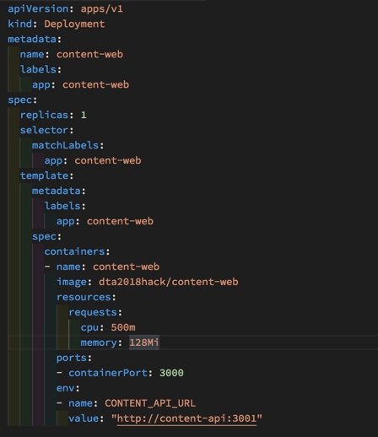
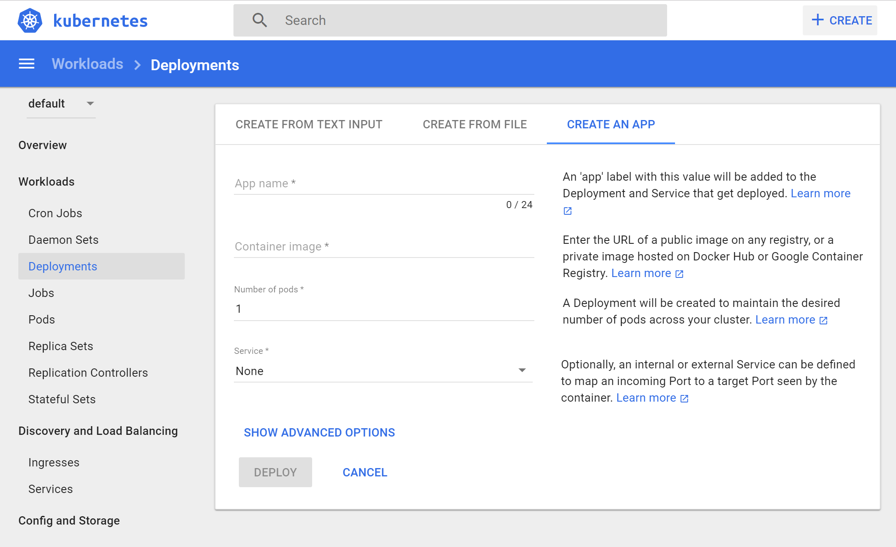
Deployments in Kubernetes
Infra-as-Code a YAML file
Manual via Kubernetes Portal

Slide 49
apiVersion: apps/
Kind: deployment
Metadata:
name: rating-web
apiVersion: apps/
Kind: deployment
Metadata:
name: rating-web
apiVersion: apps/
Kind: deployment
Metadata:
name: rating-web
customResorce
micro-web
api-server
port
8000
deployment
service
ingress
rating-web
rating-web
rating-web
port
8080
port
8080
port
8080
pod
pod
rating-web
rating-web
port
8080
port
8080

Slide 50
Challenge 2
Your First Deployment
Deploy the Fab Medical API service through the Kubernetes portal.
Test the API app from a local shell in the pod

Slide 51
Kubernetes Fundamentals (continued) Services & Networking

Slide 52
Deeper into it….
Dive deeper into networking?
Explain service endpoints (external vs internal endpoints)?
SLIDE: Show images of how traffic is routed inbound for Cluster IP, Load Balancer, or Internal

Slide 53
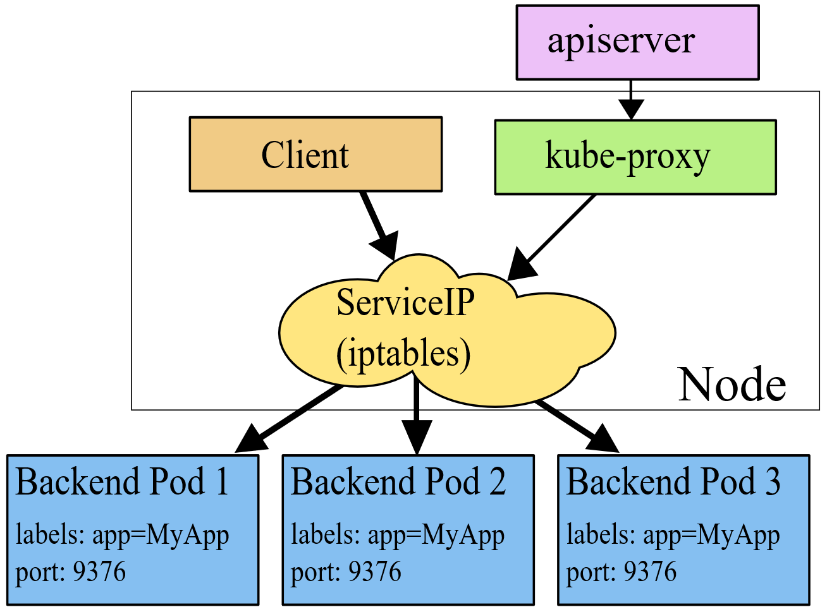
Networking in Kubernetes
Kubernetes Networking model introduces 3 methods of communications:
Pod-to-Pod communication directly by IP address. Kubernetes has a Pod-IP wide metric simplifying communication.
Pod-to-Service Communication – Client traffic is directed to service virtual IP by iptables rules that are modified by the kub-proxy process (running on all hosts) and directed to the correct Pod.
External-to-Internal Communication – external access is captured by an external load balancer which targets nodes in a cluster. The Pod-to-Service flow stays the same.
Notes:
When the backend Service is created, the Kubernetes master assigns a virtual IP address, for example 10.0.0.1. Assuming the Service port is 1234, the Service is observed by all of the kube-proxy instances in the cluster. When a proxy sees a new Service, it installs a series of iptables rules which redirect from the VIP to per-Service rules. The per-Service rules link to per-Endpoint rules which redirect (Destination NAT) to the backends.
When a client connects to the VIP the iptables rule kicks in. A backend is chosen (either based on session affinity or randomly) and packets are redirected to the backend. Unlike the userspace proxy, packets are never copied to userspace, the kube-proxy does not have to be running for the VIP to work, and the client IP is not altered.
This same basic flow executes when traffic comes in through a node-port or through a load-balancer, though in those cases the client IP does get altered.

Slide 54
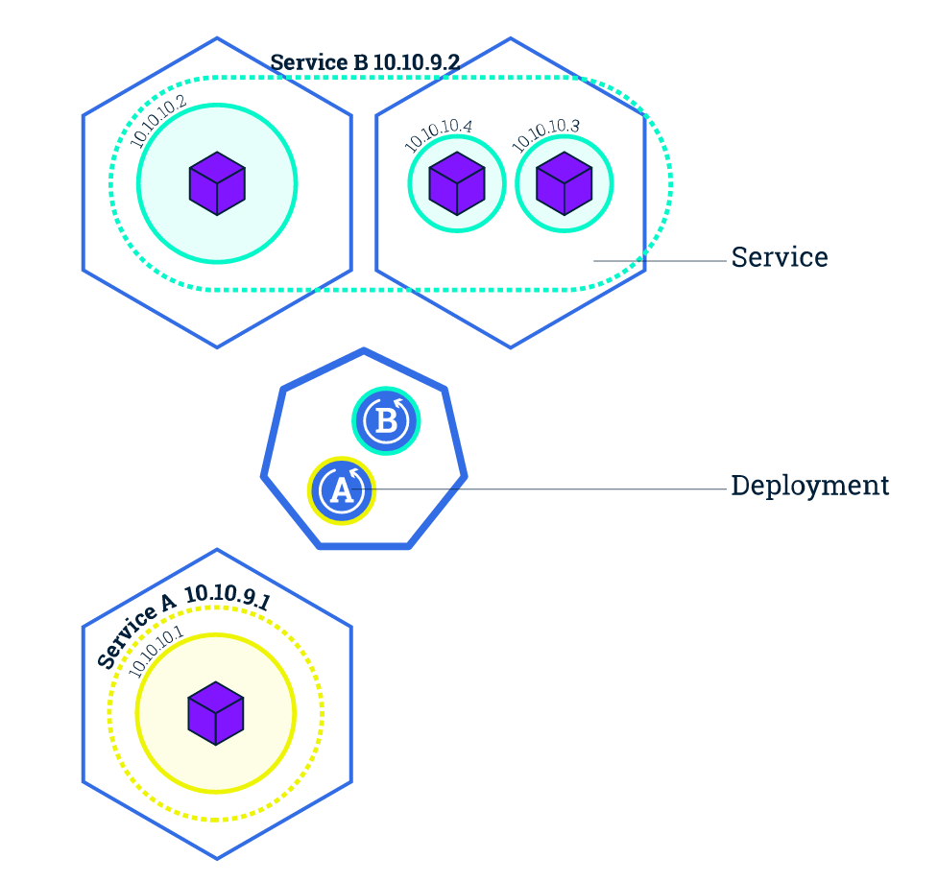
Service Discovery with Kubernetes
Nodes, Deployments, Pods, Services
Services
Expose the services
Works with platform Load Balancers to get public IPs
Internal load balancing between pods
kube-dns (preferred)
Name service enabled in Kubernetes (Default in ACS)
Environment Variables
Every Service is assigned environment variables with information of the service
REDIS_MASTER_SERVICE_HOST=10.0.0.11 REDIS_MASTER_SERVICE_PORT=6379 REDIS_MASTER_PORT=tcp://10.0.0.11:6379 REDIS_MASTER_PORT_6379_TCP=tcp://10.0.0.11:6379 REDIS_MASTER_PORT_6379_TCP_PROTO=tcp REDIS_MASTER_PORT_6379_TCP_PORT=6379 REDIS_MASTER_PORT_6379_TCP_ADDR=10.0.0.11
Source: https://kubernetes.io/docs/tutorials/kubernetes-basics/expose-intro/
Notes:
NOTE ON ENVIRONMENT VARIABLES: This does imply an ordering requirement - any Service that a Pod wants to access must be created before the Pod itself, or else the environment variables will not be populated. DNS does not have this restriction.

Slide 55
Ingresses
Typically, services and pods have IPs only routable by the cluster network
All traffic that ends up at an edge router is either dropped or forwarded elsewhere
Ingress is a collection of rules that allow inbound connections to reach the cluster services
An Ingress controller is responsible for fulfilling the Ingress, usually with a loadbalancer, though it may also configure your edge router or additional frontends to help handle the traffic in an HA manner
Notes:
I
Pods won’t survive scheduling failures, node failures, or other evictions, such as due to lack of resources, or in the case of node maintenance.

Slide 56
Container Network Interface (CNI)
CNI (a CNCF project) is a spec for plugins to configure Linux container network interfaces
Wide range of support
Kubernetes, OpenShift, Cloud Foundry, Mesos, rkt, etc.
Examples
Calico, Weave, Contiv, etc.
Azure CNI plug-in integrates Azure VNET into kubernetes clusters
Use acs-engine
Notes:
CNCF = Cloud Native Computing Foundation
https://github.com/Azure/azure-container-networking/blob/master/docs/acs.md

Slide 57
Challenge 3
Your Second Deployment
Deploy the Fab Medical Web app using YAML files.
Ensure that the Web app knows where to find the API service deployed previously.
Create a service for the web app that is accessible from outside the cluster.
Test the app and make sure speakers and session lists are showing.

Slide 58
Kubernetes Scaling & HA

Slide 59
Application Scaling Strategies
Application Level
Increase/decrease the number of pods for a given service
Handled by the orchestrator or the application itself
Kubernetes Horizontal Pod Autoscaling
Infrastructure Level
Increase/decrease the number of VM’s running in the cluster
Azure infrastructure function
via AKS API/CLI (utilizes Azure VM Scale Sets)
Auto-scaling coming to AKS soon
These functions should be coordinated

Slide 60
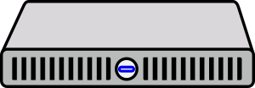
Scaling Pods
Pod
Pod
Pod
Pod
Pod
Pod

Slide 61
Scaling Nodes
Pod
Pod
Pod
Pod
Pod
Pod
Pod
Pod

Slide 62
Scaling the AKS Cluster

Slide 63
Challenge 4
Scale ‘er up!!!
Modify and re-apply your YAML files to scale your apps.
Scale the web app to 2 instances
Scale the API app to 4 instances
Fix any capacity issues that arise.
Inspect how the load balancer changes its redirection of traffic during scaling.

Slide 64
Kubernetes Updates & Rollbacks

Slide 65
Rolling Updates and Roll-Backs
Incremental update of a deployment (ie: set of pods).
Service will load balance between the old and the new until the old versions are all terminated.
Similar to scaling.
All updates are versioned and can be rolled back.
Roll backs use the same mechanism to deploy the new pods.

Slide 66
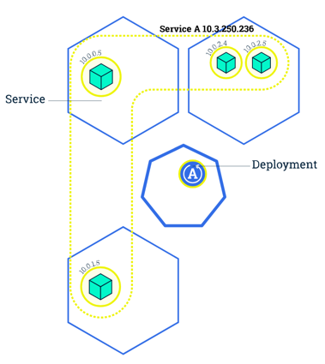
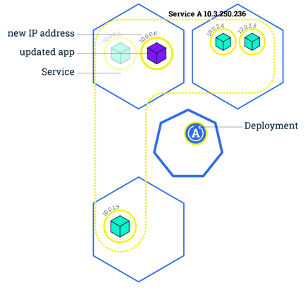
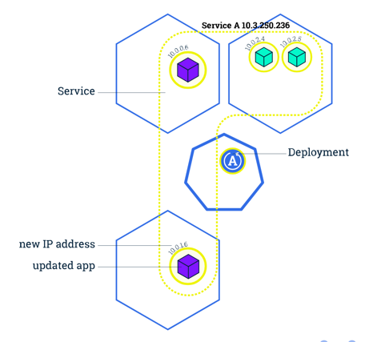
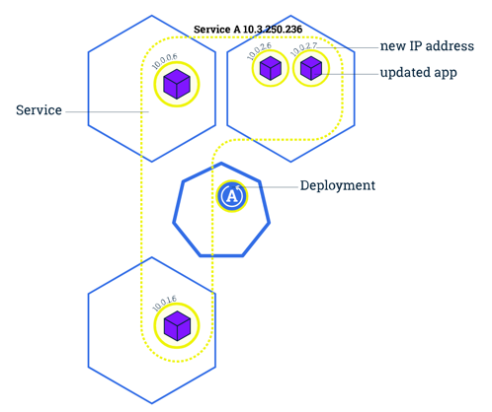
Rolling Updates and Roll-Backs

Slide 67
Rolling Updates and Roll-Backs

Slide 68
Blue/Green Deployments
Some applications can not handle rolling updates
Shared state, API schema changes, etc.
In these cases a Blue/Green deployment is needed
Similar to Azure’s concept of Deployment Slots
New deployment creates all Pod replicas with a new label.
When finished, we update the Service to point to the new label.

Slide 69
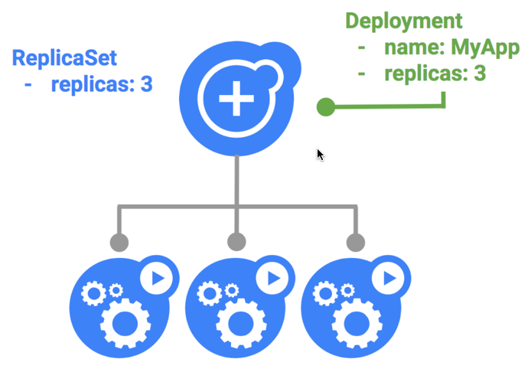
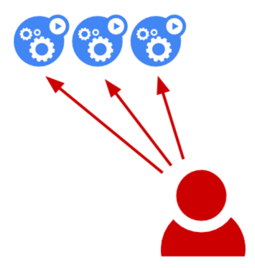
Blue – The Initial Deployment

Slide 70
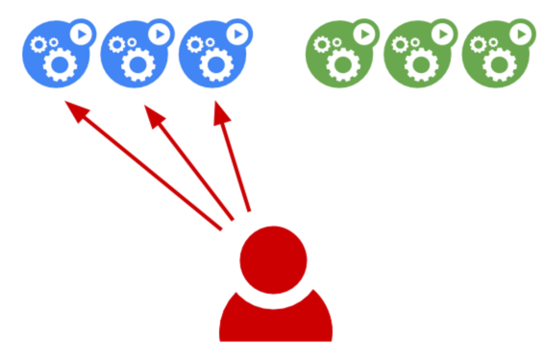
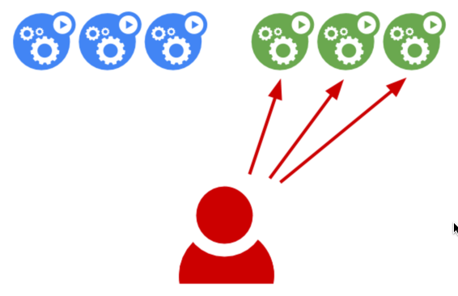
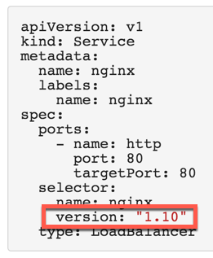
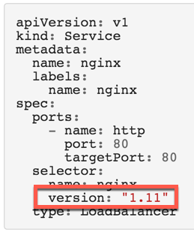
Green – The New Deployment

Slide 71
Challenge 5
Rolling Update and Roll-Back
Perform a rolling update to a new version of the Web app
Watch how the update rolls out by testing the Web app.
Roll back to the original version.
Roll back an application
Perform the update again, this using the blue/green methodology.

Slide 72
Operationalizing K8S Monitoring

Slide 73
Explain monitoring stuff here….
Monitoring
Many options available.
SLIDE: list of monitoring options
Explain which options are popular/common and why?
Explain what Azure has to offer.
Introduce concept of storage here
This is a k8S fundamental, but we don’t have time to get into it today. However, it’s worth spending time on this in longer form with your customers
Full example uses CosmosDB or Mongo DB running in a pod?

Slide 74
Monitoring

Slide 75
Current monitoring is static in nature

Slide 76
Need to monitor for dynamic environments
Pod
Pod
Pod
Pod
Pod
Pod
Pod
Pod
Pod
Pod
Pod
Pod
Pod
Pod
Pod
Pod

Slide 77
Application Health and Readiness
Kubelets on workers use liveness and readiness probes to know when to restart a container or start directing traffic
Liveness check: when to restart
Readiness check: when to forward Service traffic to a pod
Notes:
Look at liveness
Look at readiness

Slide 78
Monitoring: What indicators matter in Kubernetes
Cluster health: total number of nodes, pods, etc
Node health: available compute resources, health
Application health
Tooling Examples
Datadog
Prometheus
InfluxData
Cloud-specific: OMS (Azure), CloudWatch (AWS)
Notes:
https://docs.datadoghq.com/integrations/kubernetes/

Slide 79
Logging
Pod logs: applications must log to standard out!
Cluster-wide event logs
Logging forwarder solutions
fluentd
logstash
Log indexers
OMS Log Analytics
Splunk
ELK stack

Slide 80
Challenge 6
Deploy Some Monitoring Tools in your K8S Cluster
Configure Persistent Volumes
Deploy applications that use PVs
Use Israel’s script & poke around
Note use of storage

Slide 81
Challenge 6
Monitor Your Cluster With Different Tools
What is “built in”
Operations Management Suite / Log Analytics
Solutions
Prometheus

Slide 82
Hour Five Operations

Slide 83
Challenge 6
Giving Your App Persistent Storage
Configure Persistent Volumes
Deploy applications that use PVs

Slide 84
Hour Six Advanced Deployments

Slide 85
Challenge 6
Building Your First Helm Chart
Cluster - Multiple worker pools
Applications - Helm Charts
Different storage: NFS, SMB, Ceph, Cinder and Swift

Slide 86
Hour Seven DB in a Container?

Slide 87
Challenge 6
Building Your First Helm Chart
Run a RDMS database (SQL, MySQL, PostgreSQL) in Kubernetes
Run a RDMS database in a master/slave configuration
Run a NoSQL (Mongo/Cassandra) in Kubernetes
Run a NoSQL (Mongo/Cassandra) in Kubernetes with multiple replicate/shards

Slide 88
Hour Eight Geo Redundancy

Slide 89
Challenge 8
Federate Your Cluster
Add federation to your AKS cluster.

Slide 90
Hour Nine OpenShift on Azure

Slide 91
Challenge 9
Installing OpenShift
Install OpenShift on top of your AKS cluster.

